Slide 1
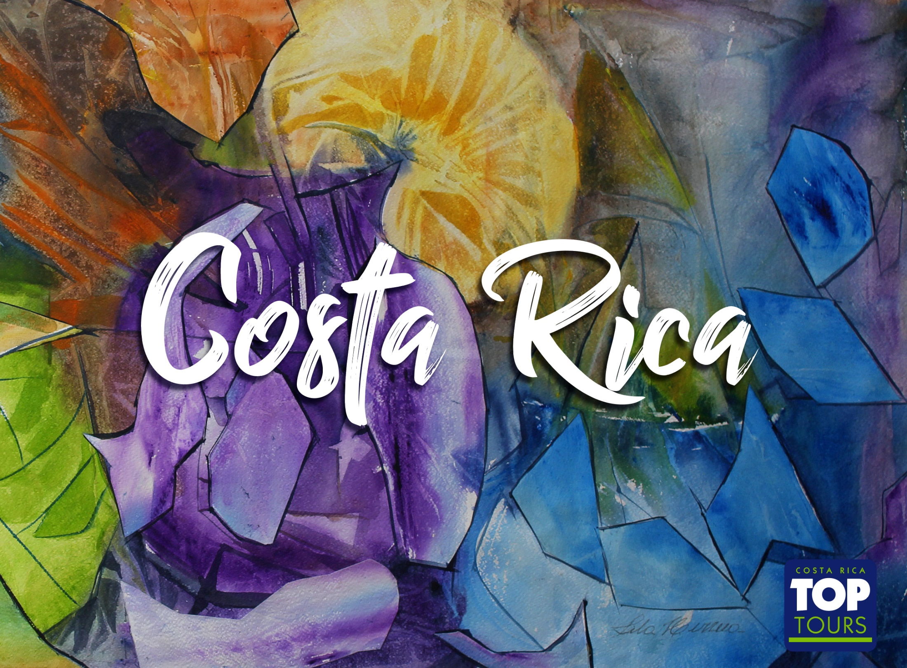


Slide 2
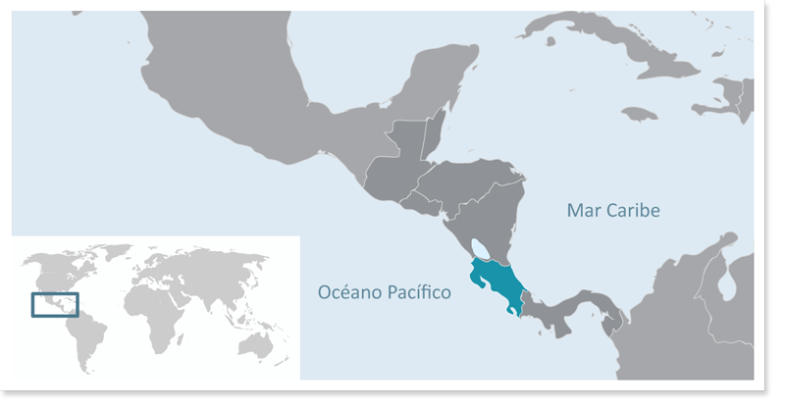
Location
Central America
Limits:
North: Nicaragua.
South: Panamá.
West: Pacific Ocean.
East: Caribbean Sea, Atlantic Ocean.

Slide 3


International Airports:
Apto. Intl. Juan Santamaría
Apto. Intl. Daniel Oduber

Slide 4

General Facts
Government: Presidential Democracy.
Division: 7 provinces.
Capital: San José.
Population: 4.579.00.
Official language: Spanish.
Official religion: Catholic.
Currency: Colón (¢).
Electricity: 110 Voltios.
Dry season : Second half November – April (dry).
Green season: May – First half November (rainy).

Slide 5
General Facts
More than 600 Species of plantas
230 Species of animals
760 Species of birds
More than1300 Species de trees
More than800 Species of ferns
More than1000 Species of orchids
25.58%
6% of the world’s Biodiversity
25.58% of the Territory is protected

Slide 6
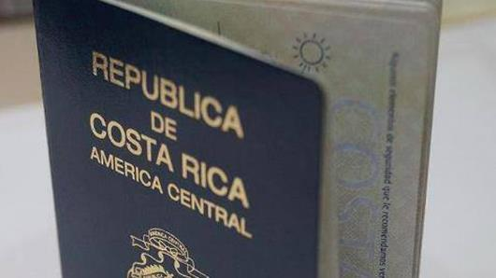
Entrance requirements:
Passport valid for at least 6 months from your date of entry
Please check if clients require the Yellow Fever Vaccine to enter the country: Countries that require Yellow Fever Vaccine
Please check if you require a visa to enter Costa Rica using the following link https://migracion.go.cr/Paginas/Visas.aspx

Slide 7
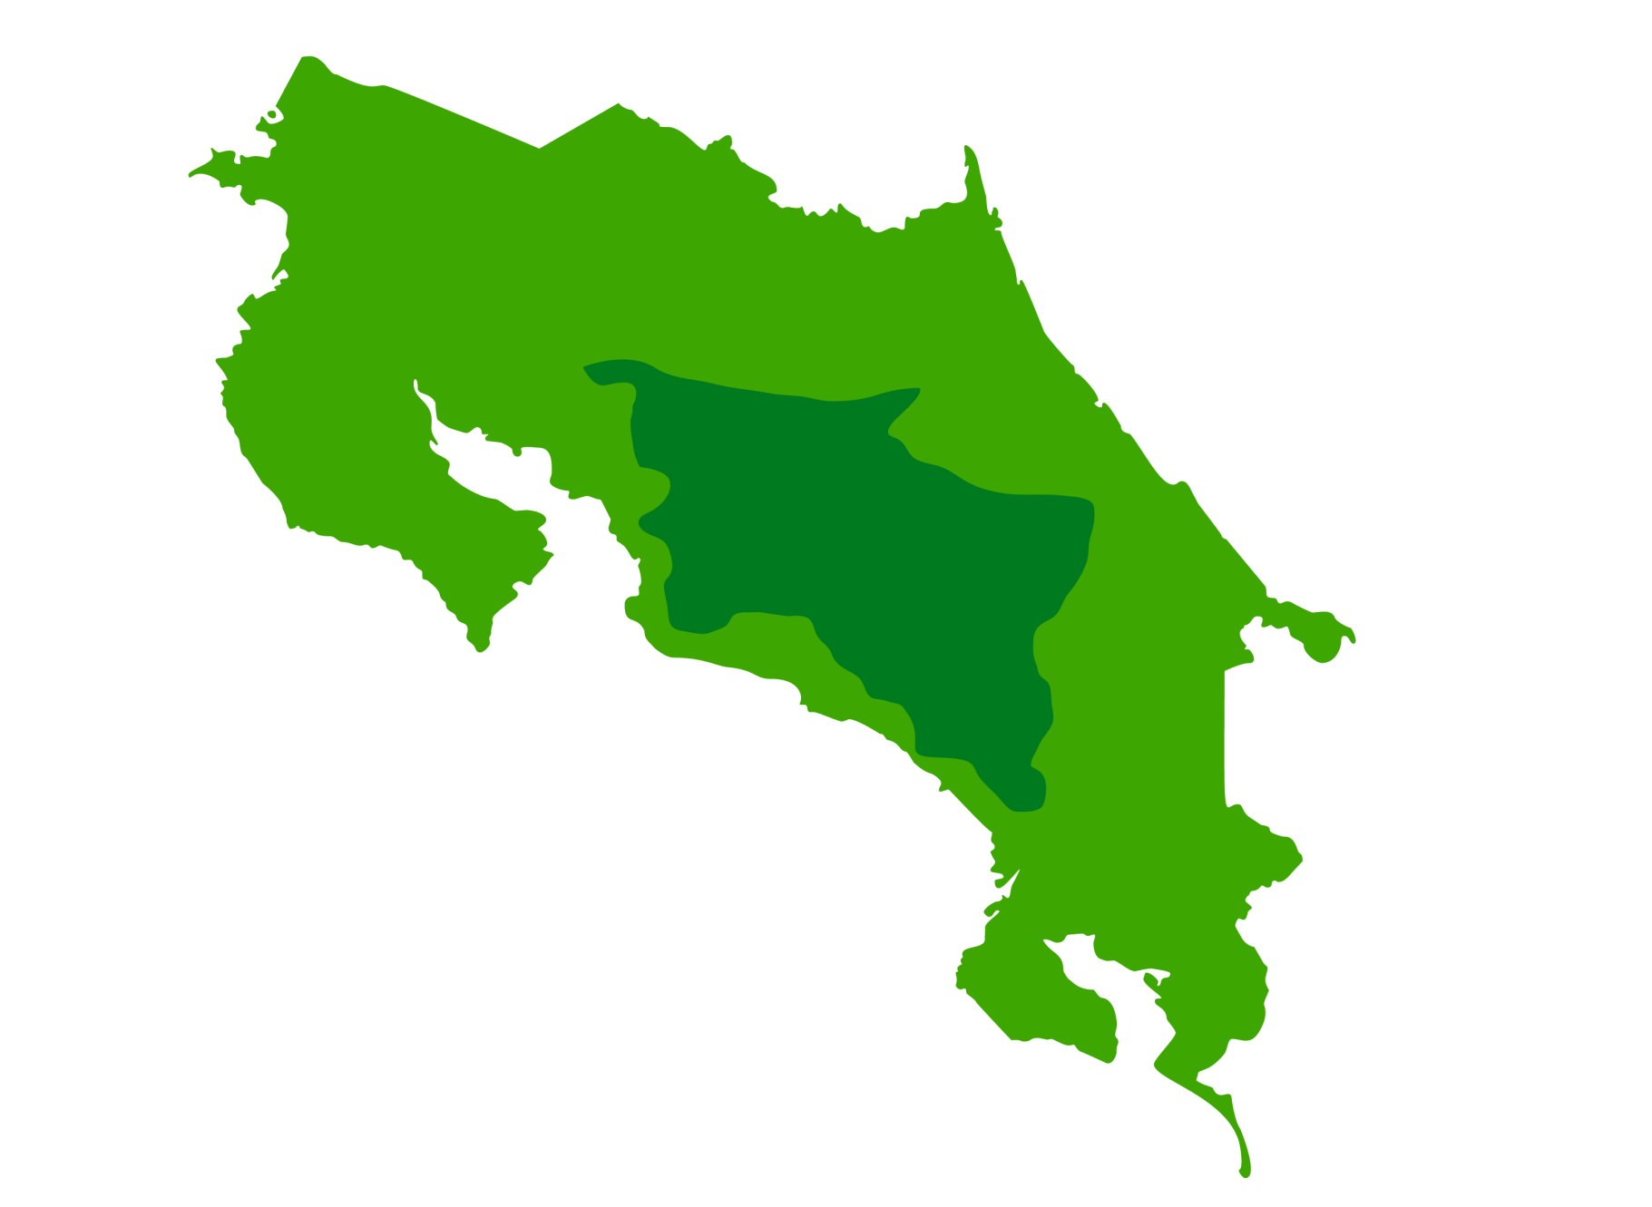

San José
Apto. Intl. Juan Santamaría
San José

Slide 8

Hotel Grano de Oro
San José

Slide 9
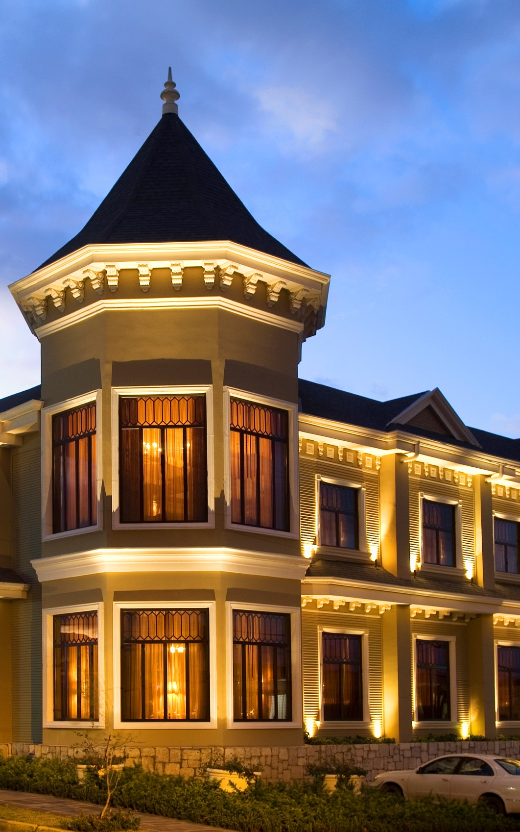

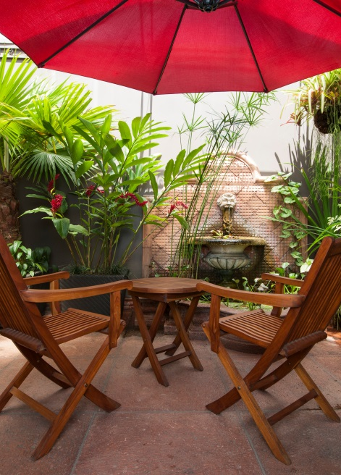
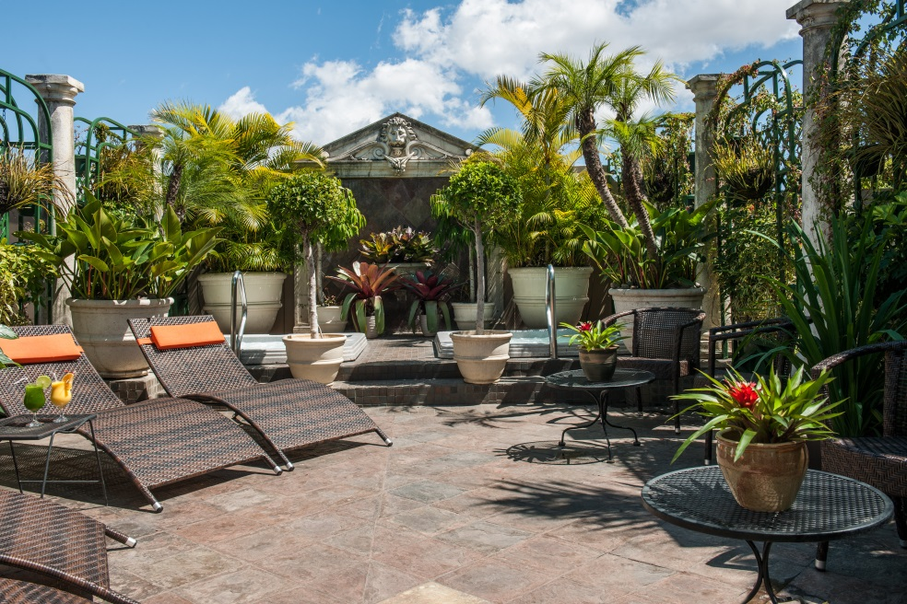
Hotel Grano de Oro

Slide 10
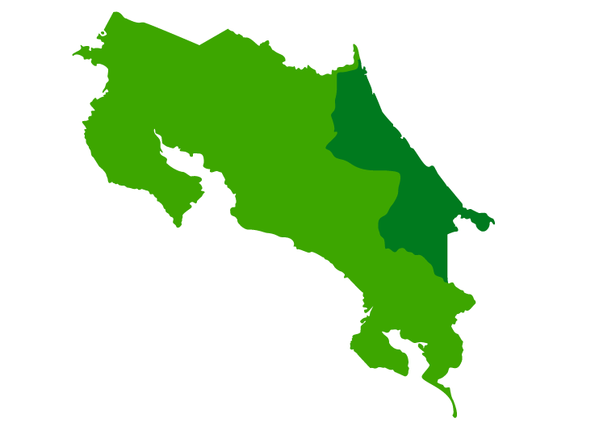
Pacuare
Pacuare

Slide 11
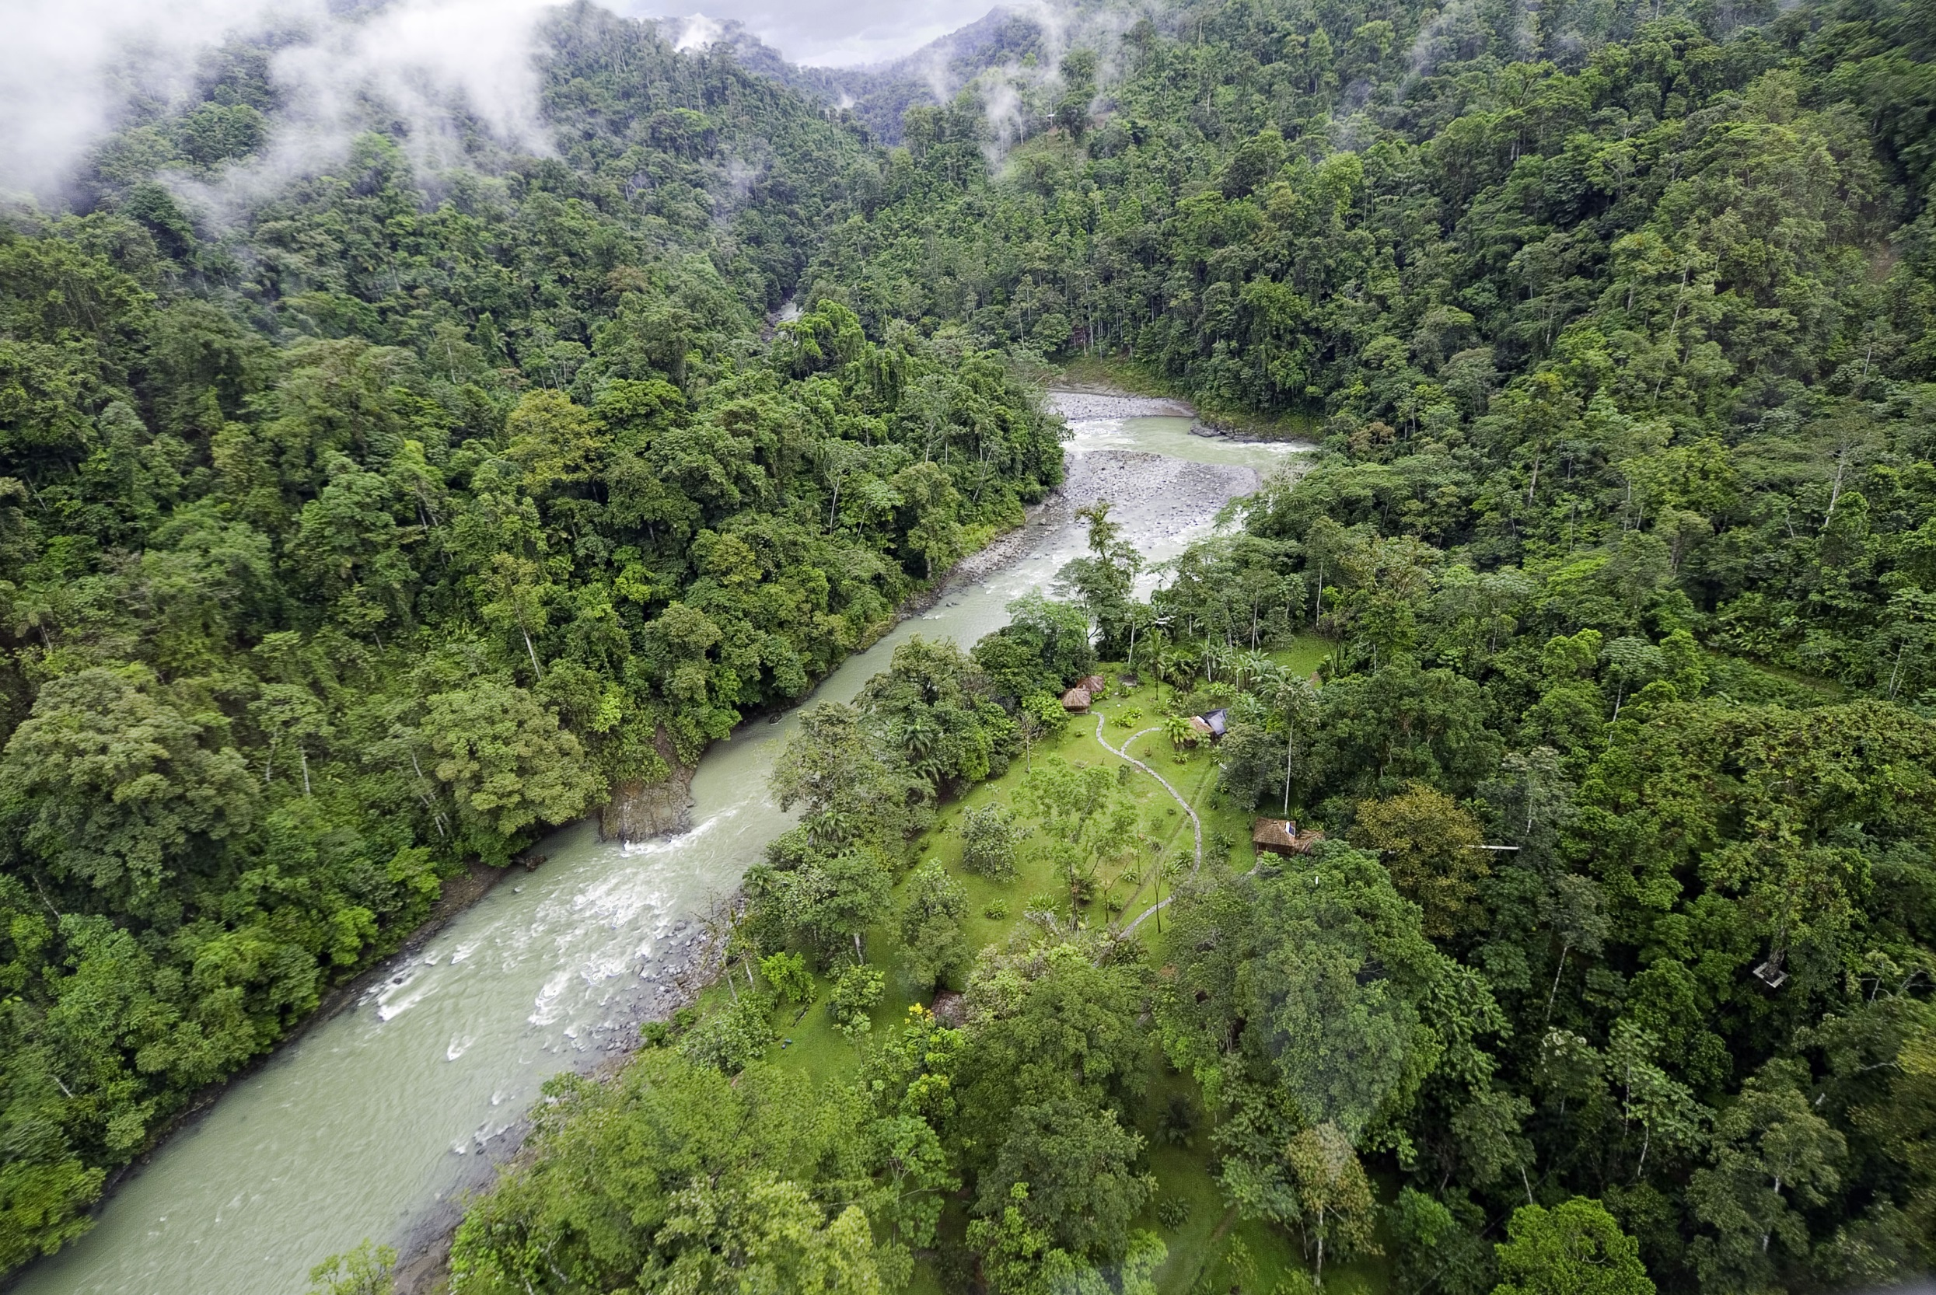
Pacuare Lodge

Slide 12
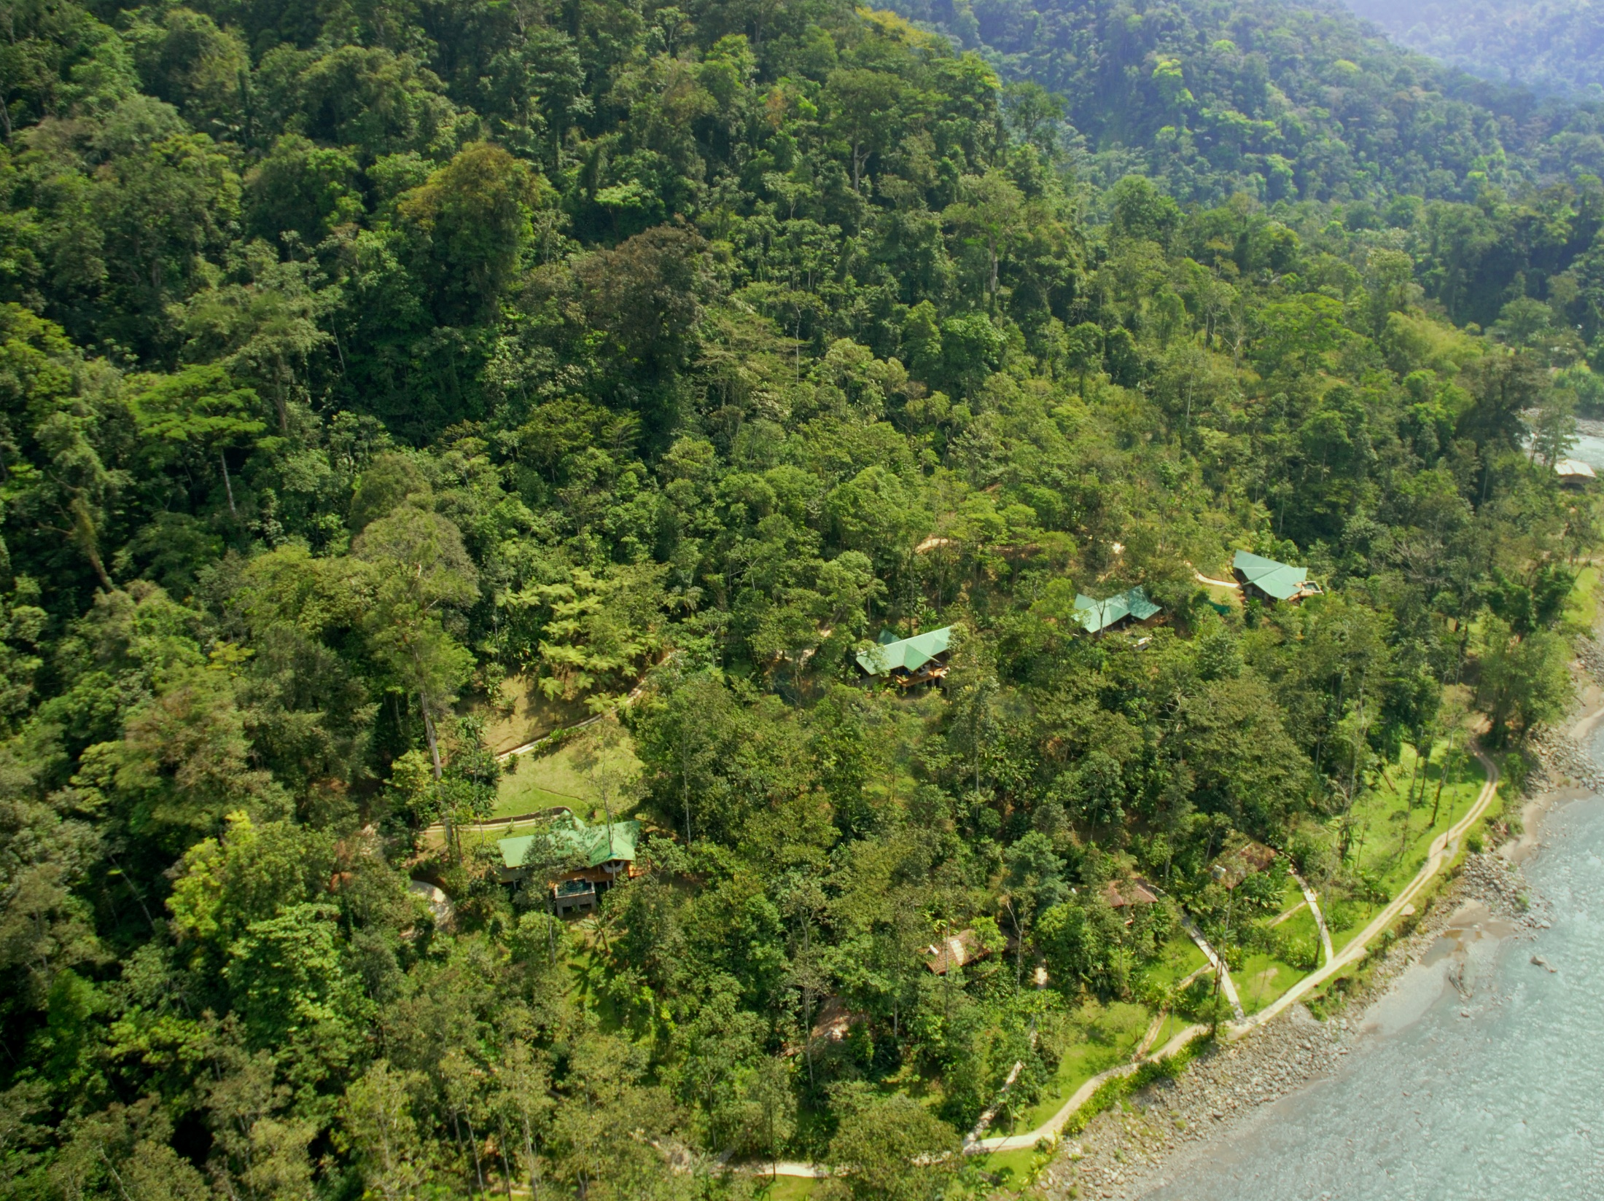

Slide 13
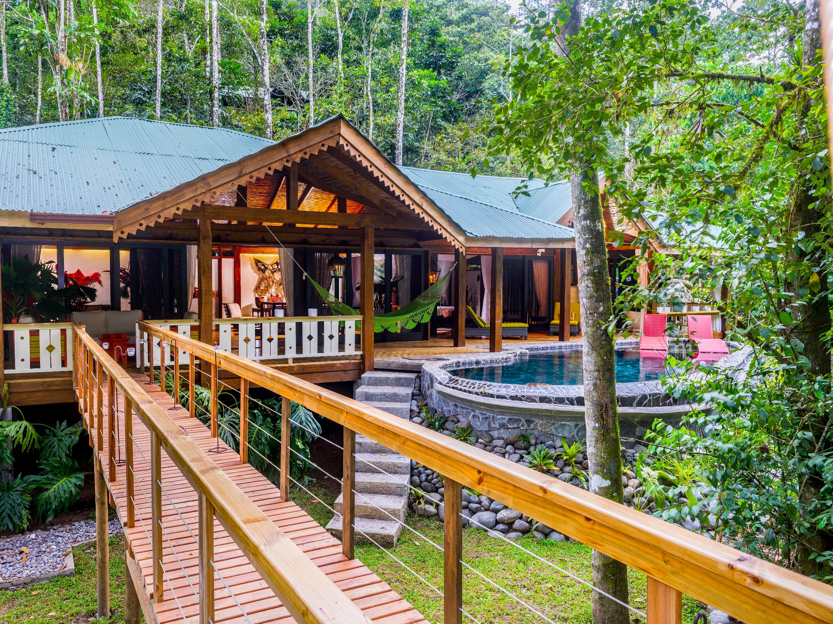

Slide 14
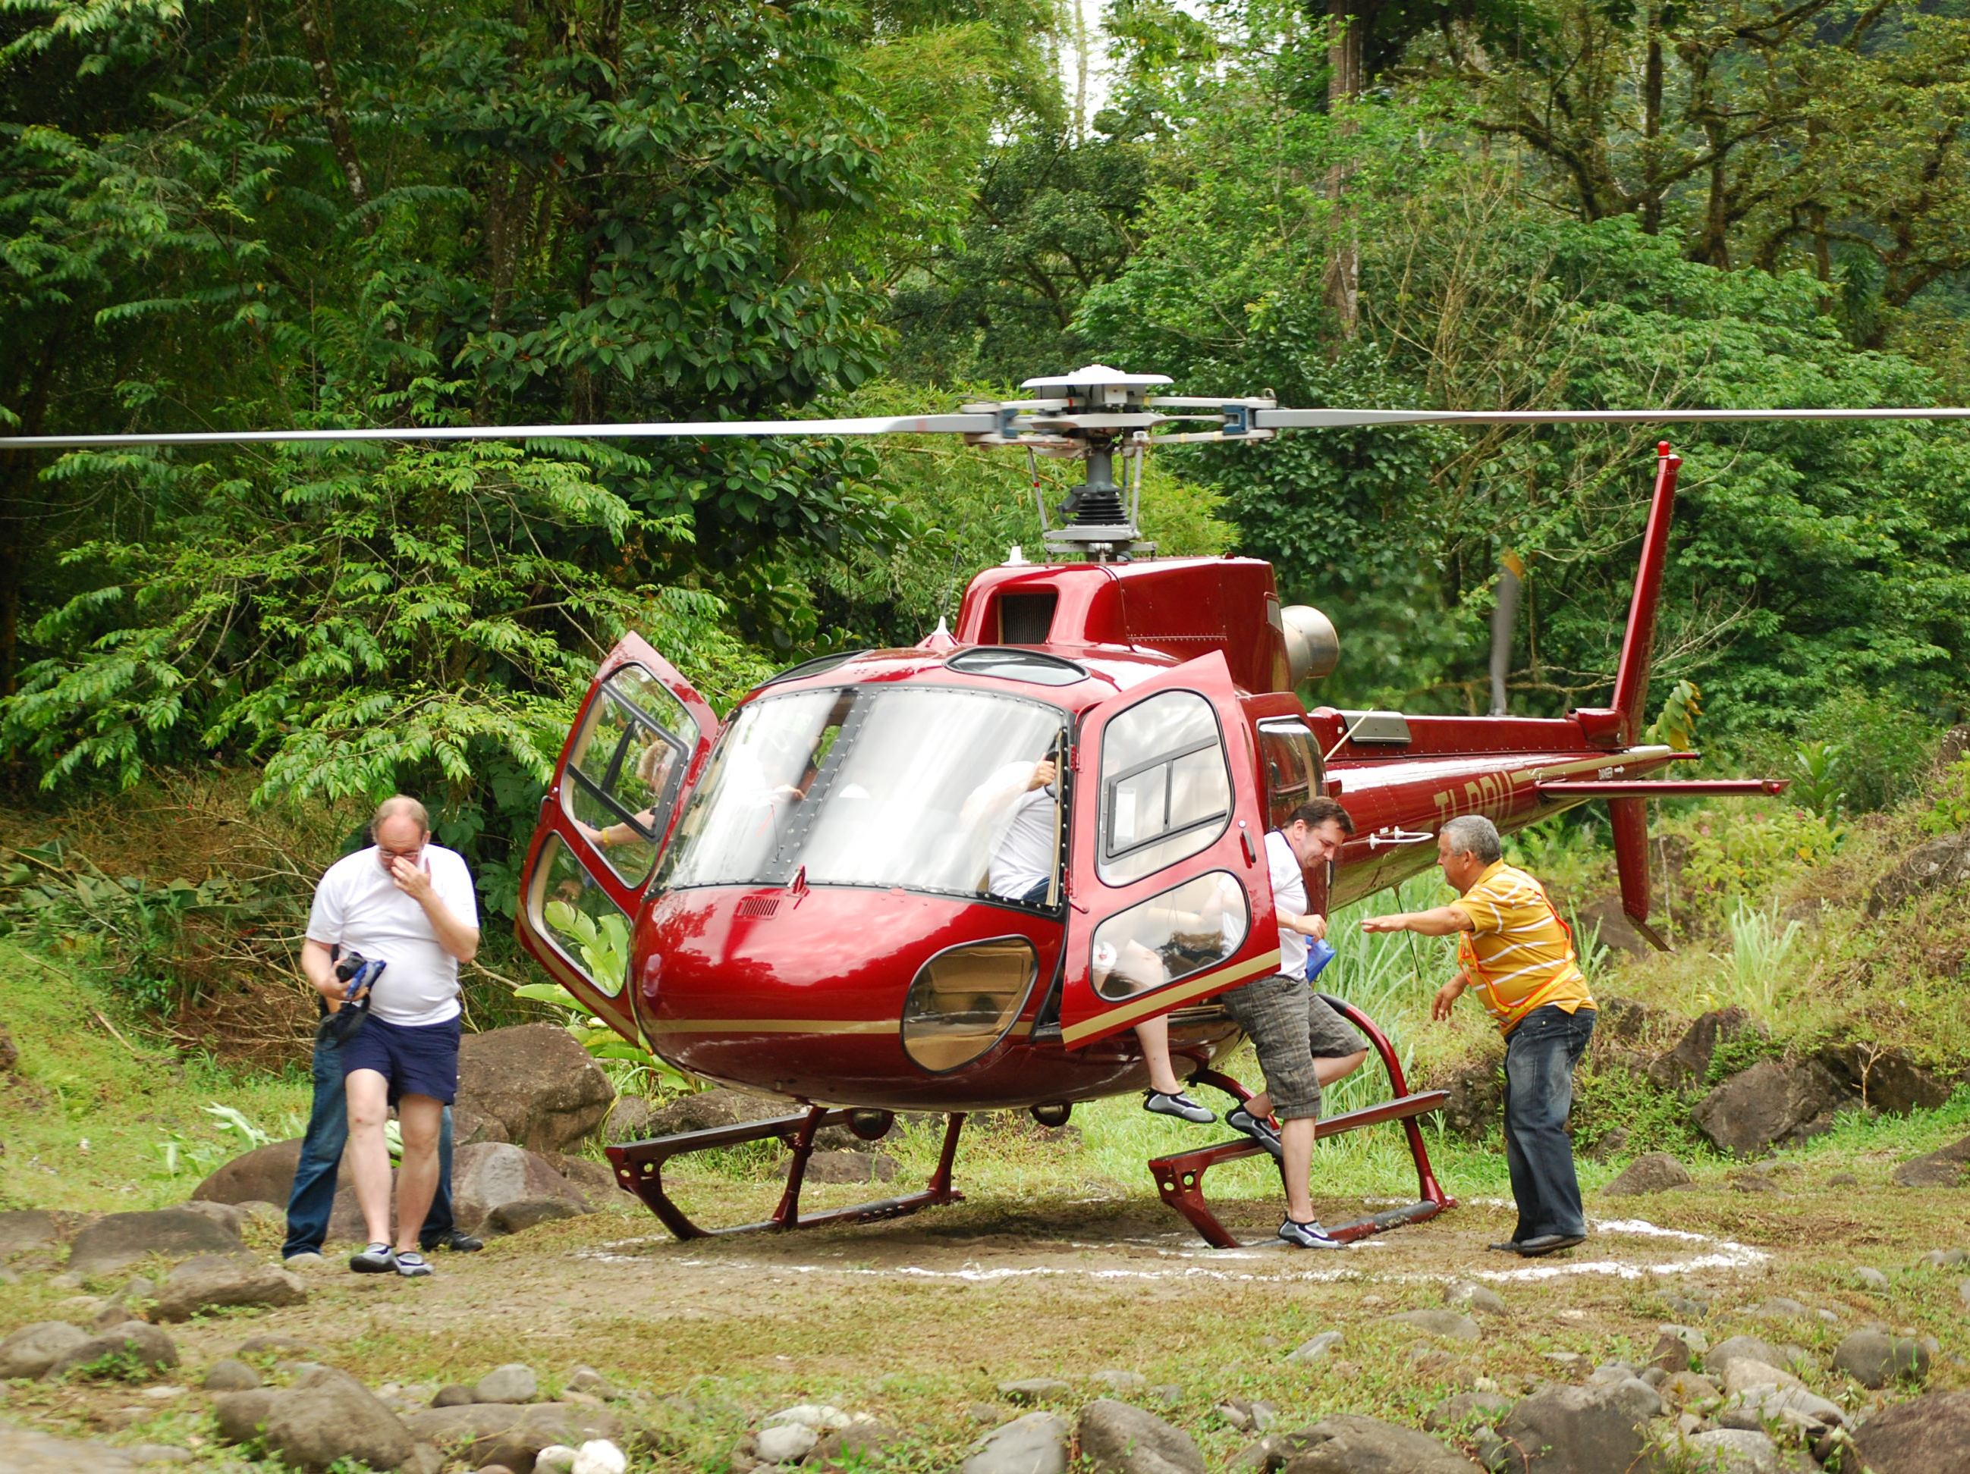

Slide 15
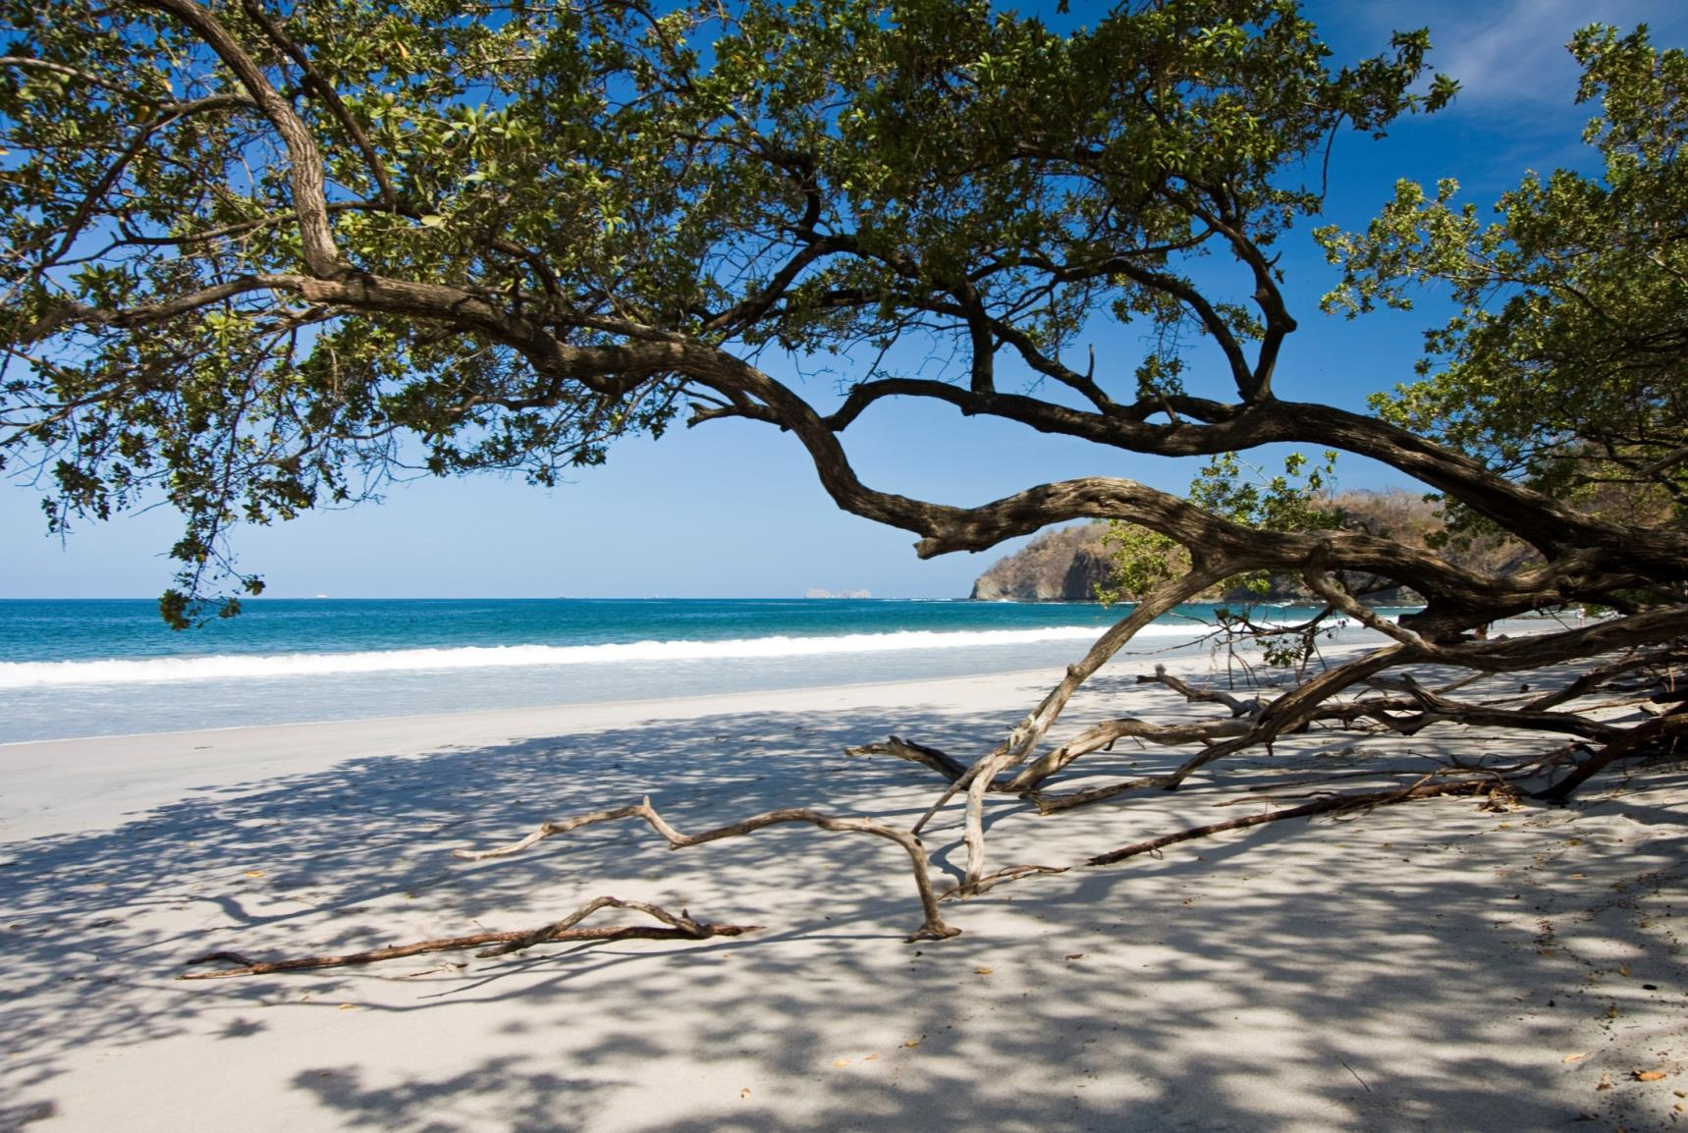
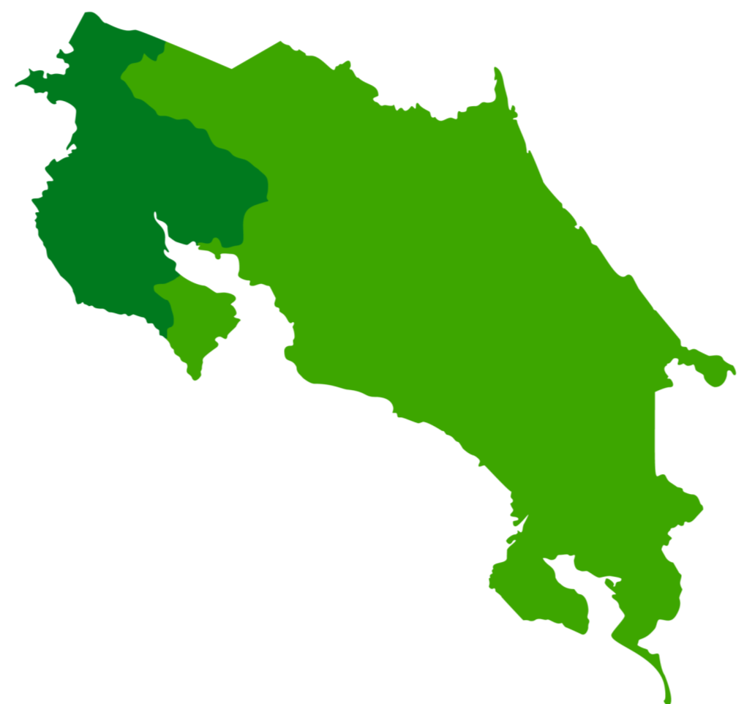
South Caribbean
Cocles

Slide 16
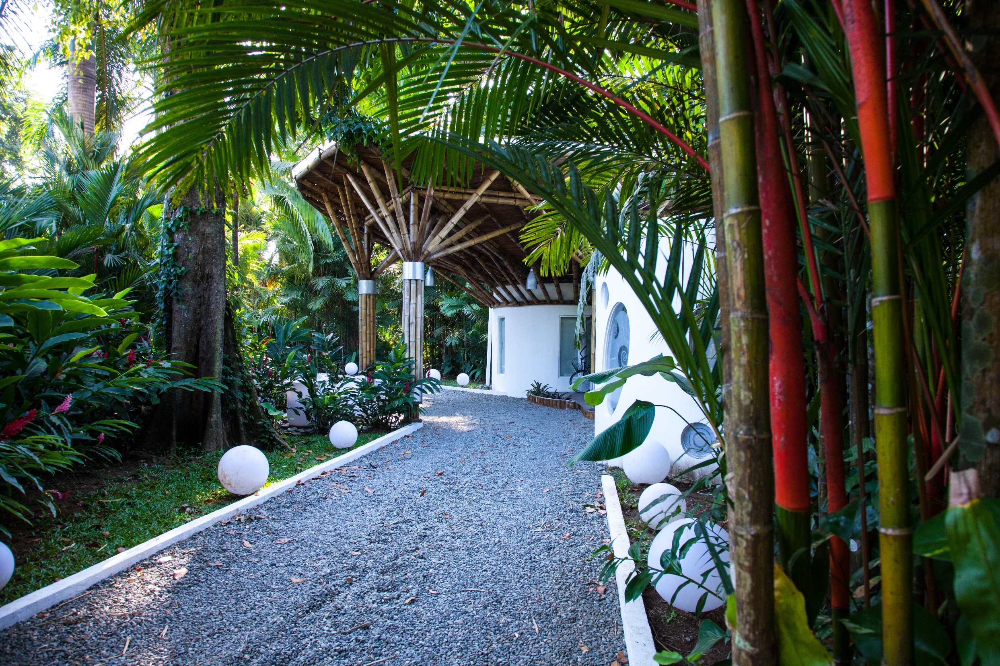
Le Camaleon

Slide 17


Slide 18


Slide 19


Slide 20
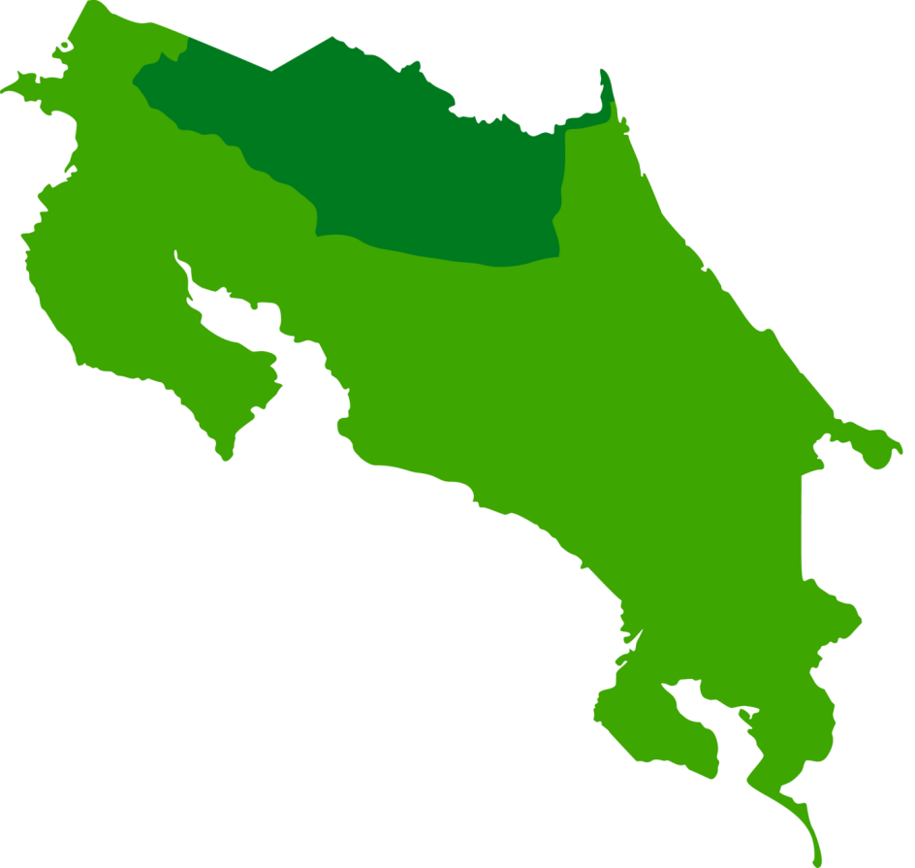
Mountain
La Fortuna - Arenal

Slide 21
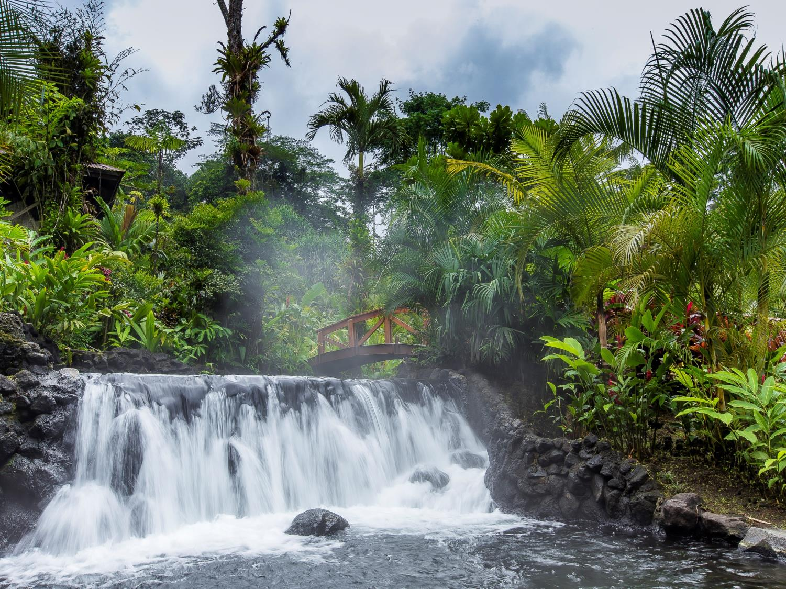
Tabacón Grand Spa & Thermal Resort

Slide 22
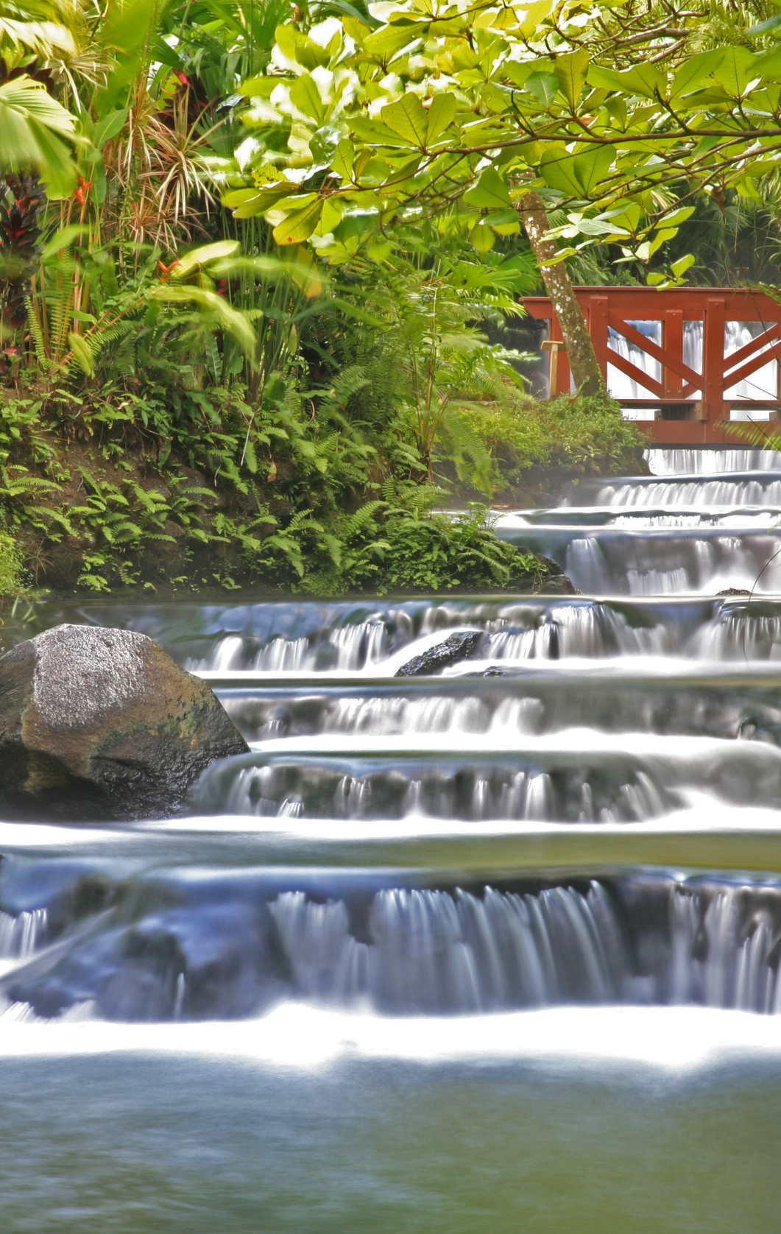

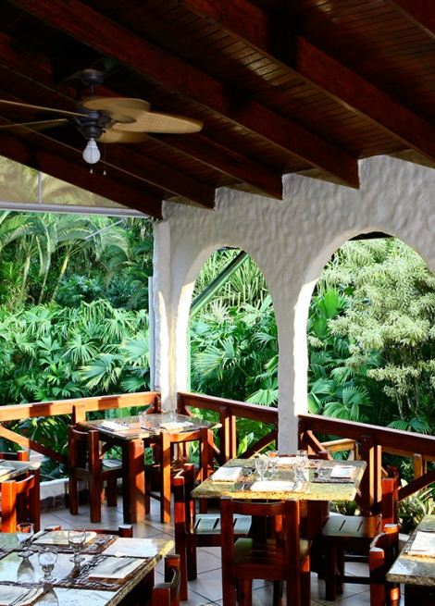
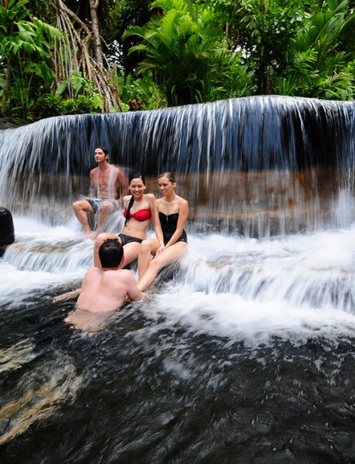
Tabacón Grand Spa & Thermal Resort

Slide 23

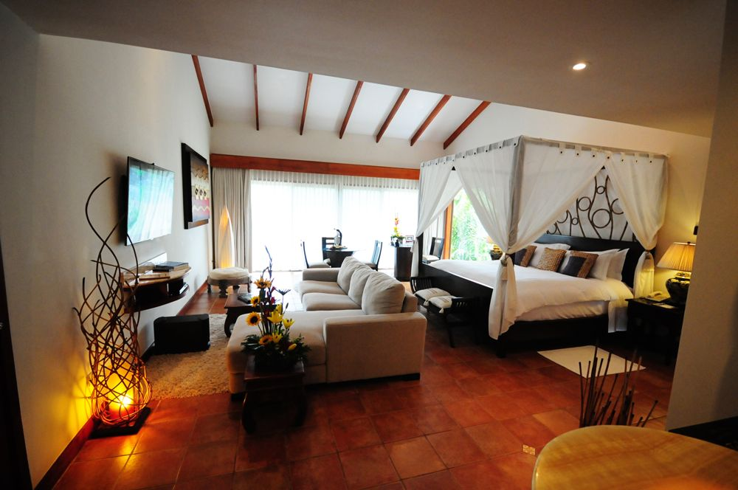

Tabacón Grand Spa & Thermal Resort – Honeymoon Suite

Slide 24
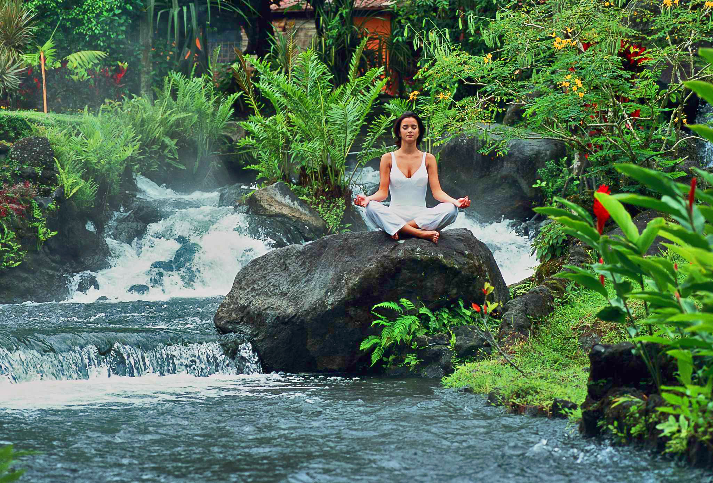
Tabacon Hot Springs

Slide 25



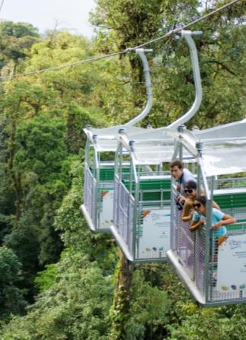
Sky Adventures Arenal

Slide 26

Costa Rica is…

Slide 27
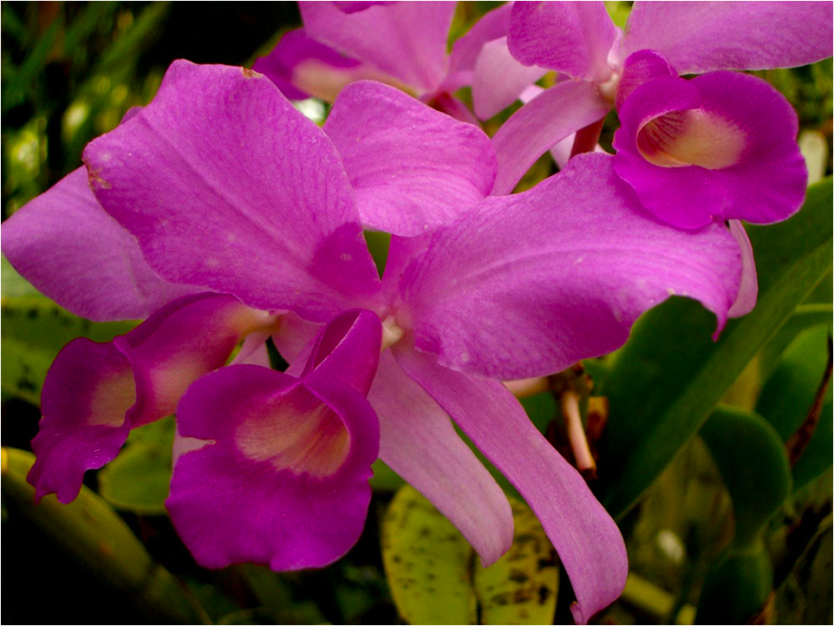
Guaria Morada

Slide 28
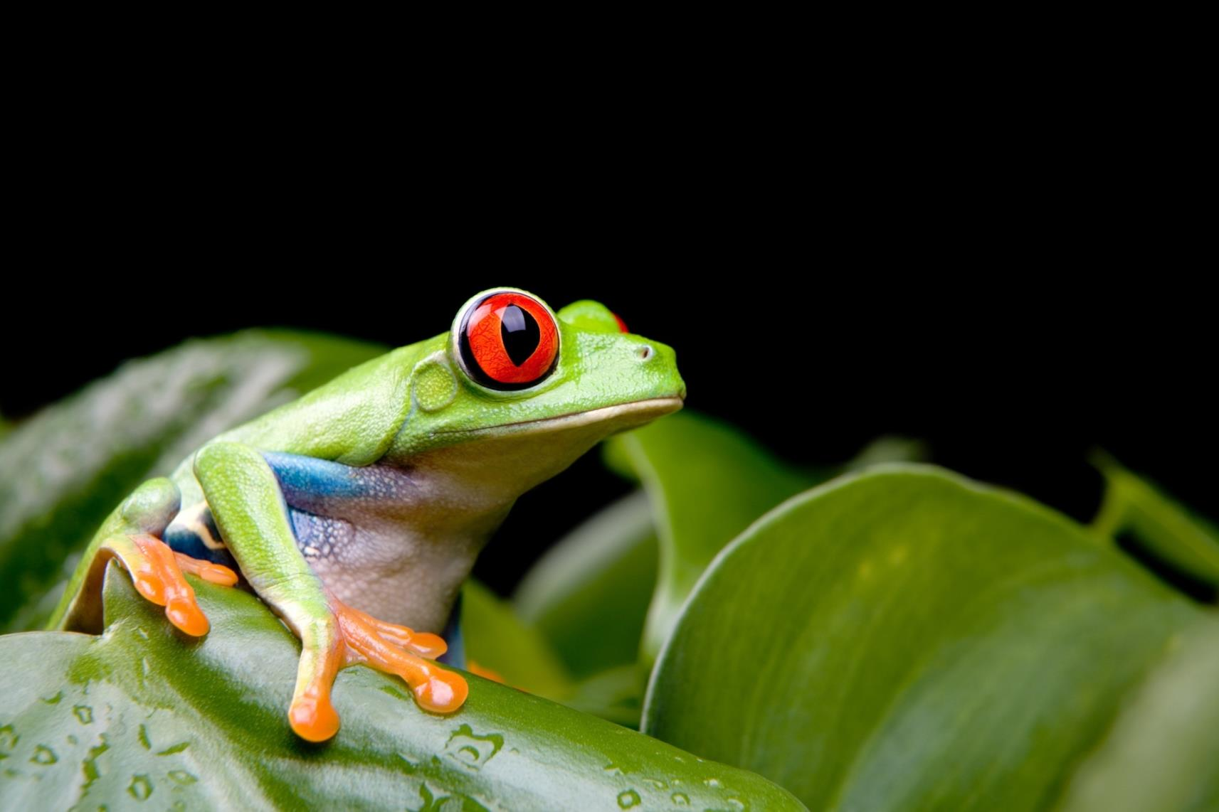
Rana Calzonuda

Slide 29
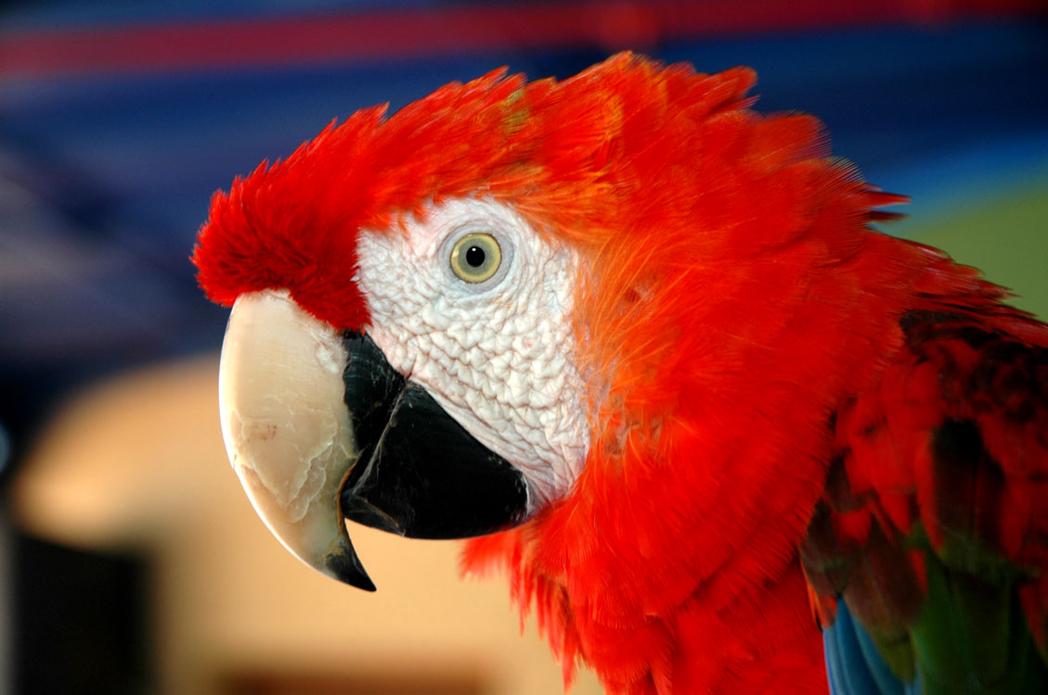
Lapa Roja

Slide 30
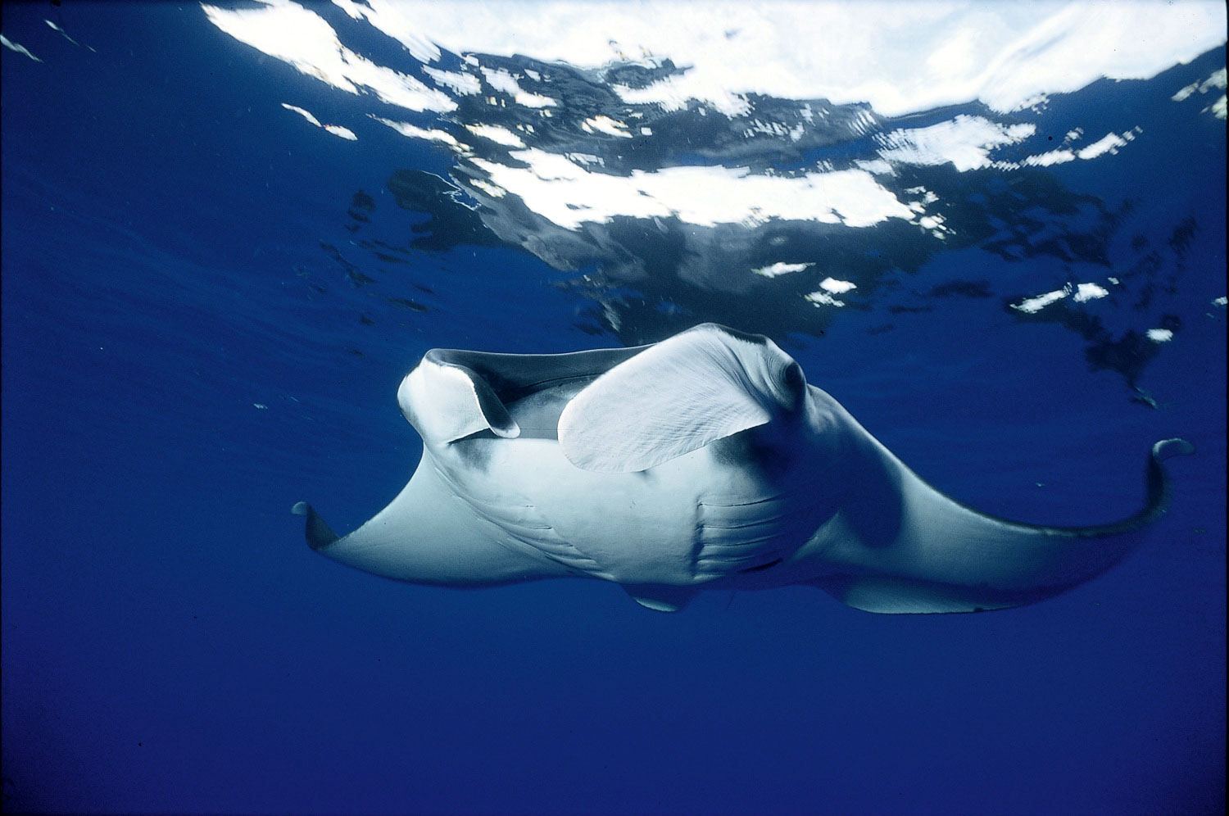
Mantarraya

Slide 31
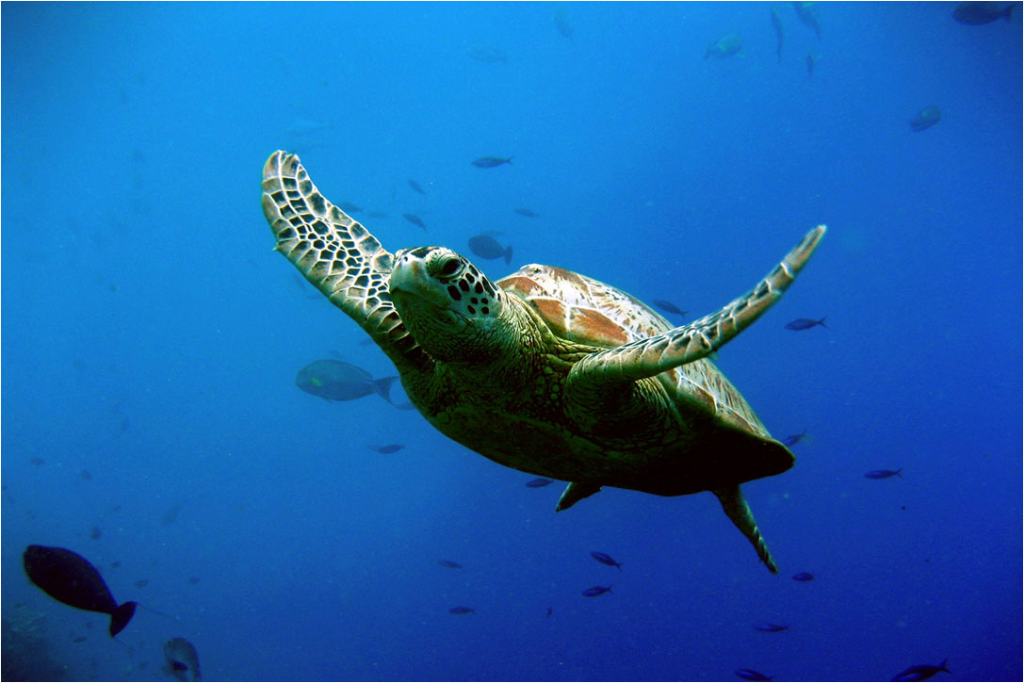
Turtle

Slide 32
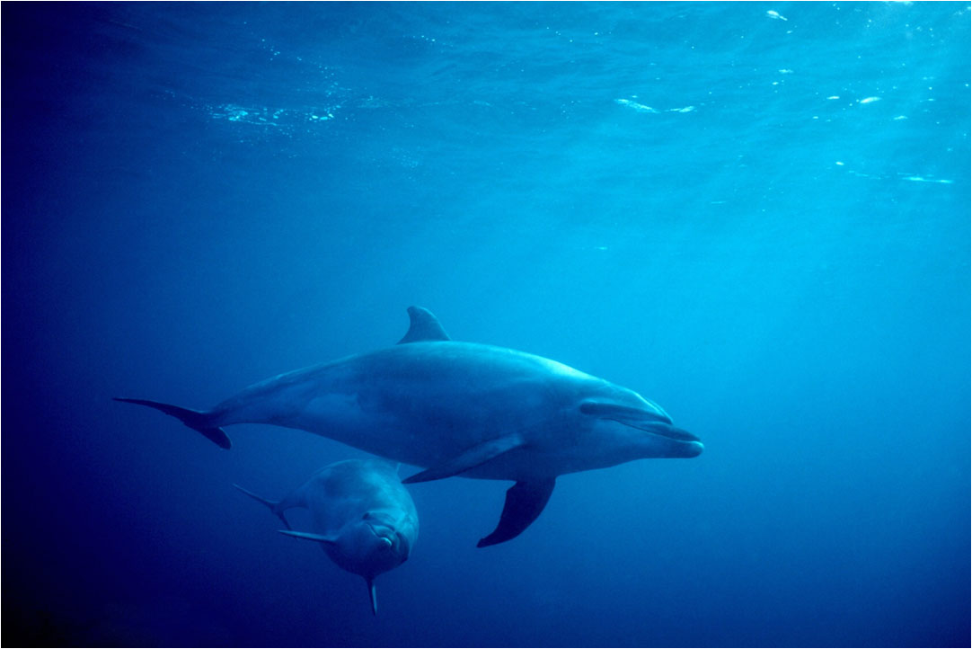
Dolphins

Slide 33
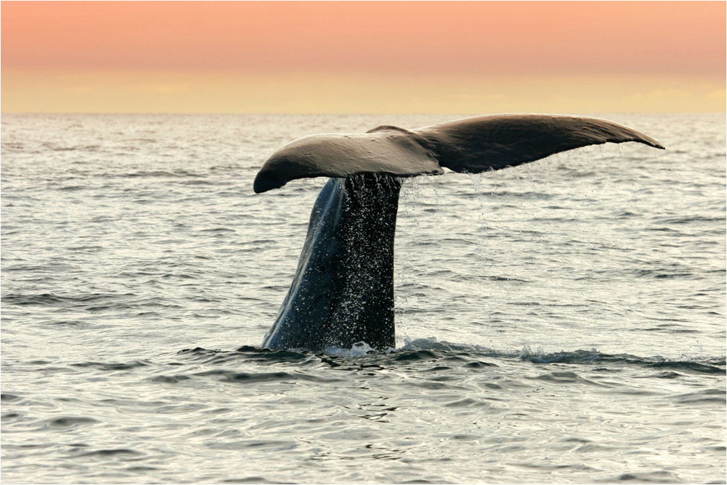
Whale

Slide 34
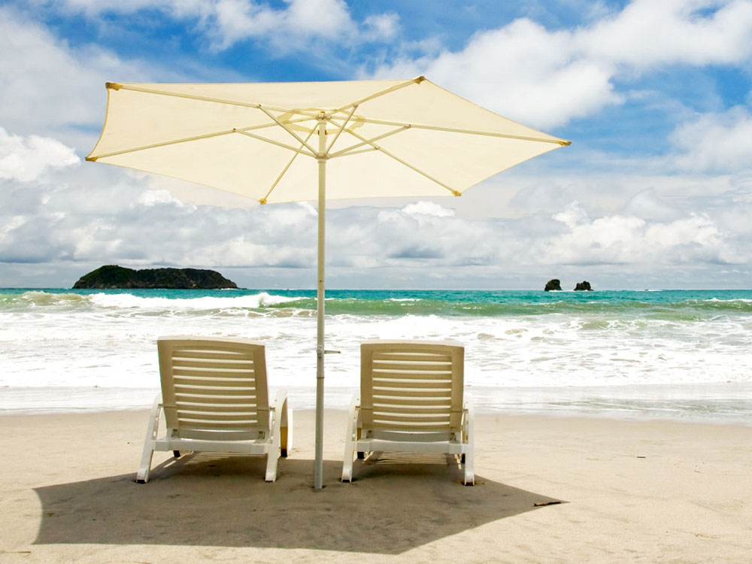
Costa Rica
Pura Vida!

